Slide 1
Gender differences in technology adoption in the presence of nonclassical measurement error
Preliminary results: Sep 2023

Slide 2
Introduction & Motivation

Slide 3
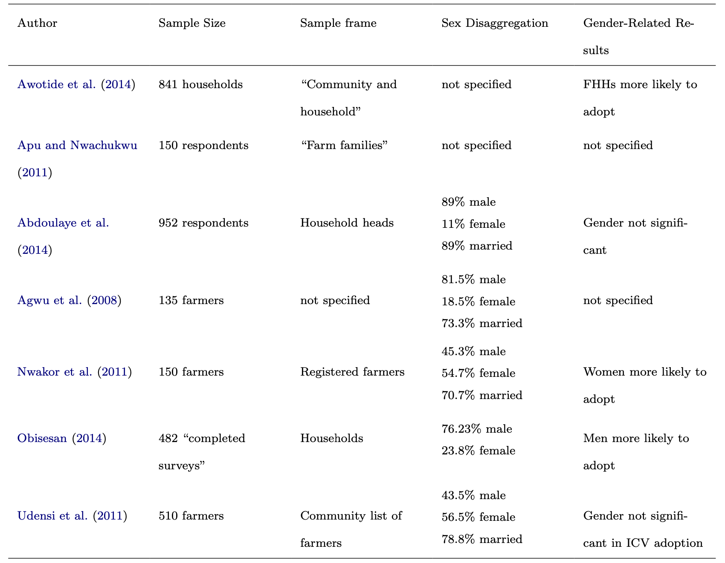
Gender perspective in economic sectors

Slide 4
Data description

Slide 5
Cassava Monitoring Survey in Nigeria
The 16 states, located across four regions (Southwest, Southeast, South-South, and North) of Nigeria, which contributed at least 80% of the total production of cassava.
Unique dataset: subset of the total survey where the interviews were conducted with both the identified head of household and an additional member of the household to create a subset of 758 households.
Final dataset: Status was married; and, both members reported living with spouse. This eliminated 29 households for a sample of 729 households.

Slide 6
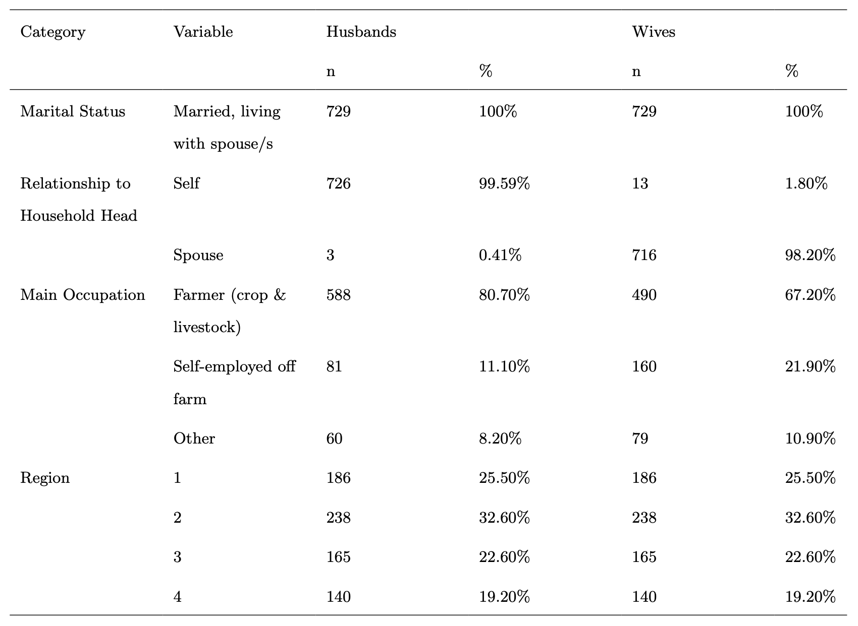
Description statistics

Slide 7
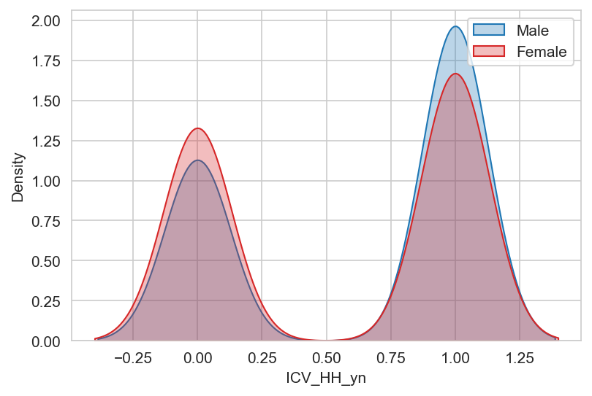
Description statistics

Slide 8
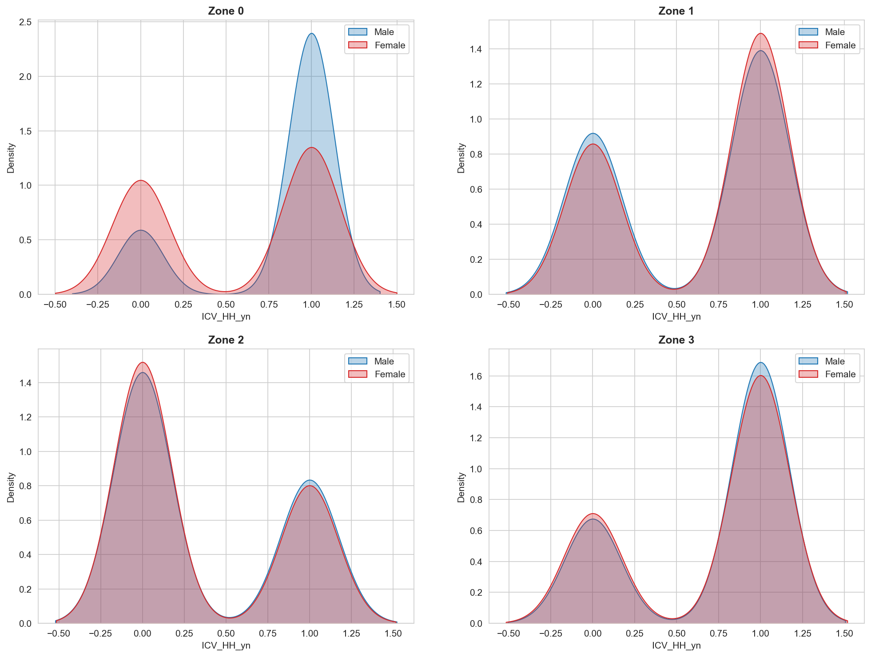
Description statistics

Slide 9
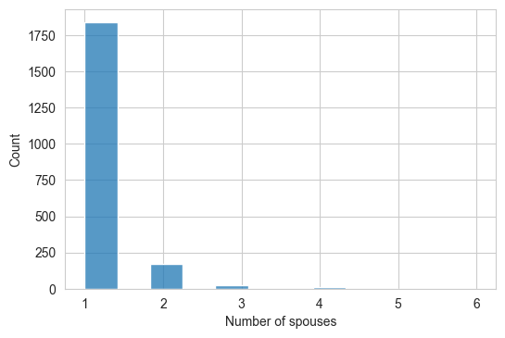
Description statistics

